Slide 1
EE227 – Digital Logic Design
Lecture 18

Slide 2
Outline
Sequential Circuits
Types of Sequential Circuits
Synchronous Sequential Circuits
Asynchronous Sequential Circuits
Storage Elements
Latches
Flip Flops
SR Latch
D Latch

Slide 3
Sequential Circuits (Background)
Today’s digital electronic devices have the ability to send, receive, store, retrieve, and process information represented in a binary format
The technology enabling and supporting these devices is critically dependent on electronic components that can store information
The digital circuits considered thus far have been combinational and don’t have any memory
Sequential circuits, however, act as storage elements and have memory
They can store, retain, and then retrieve information when needed at a later time

Slide 4
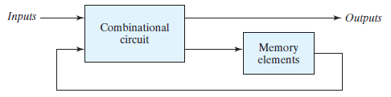
Sequential Circuits (1/2)
Sequential circuit consists of a combinational circuit to which storage elements are connected to form a feedback path
The storage elements are devices capable of storing binary information
The binary information stored in these elements at any given time defines the state of the sequential circuit at that time

Slide 5
Sequential Circuits (2/2)
The outputs in a sequential circuit are a function not only of the inputs, but also of the present state of the storage elements
The next state of the storage elements is also a function of external inputs and the present state
Thus, a sequential circuit is specified by a time sequence of inputs, outputs, and internal states

Slide 6
Types of Sequential Circuits
There are two main types of sequential circuits, and their classification is a function of the timing of their signals
Synchronous Sequential Circuits
It is a system whose behavior can be defined from the knowledge of its signals at discrete instants of time
Asynchronous Sequential Circuits
The behavior of an asynchronous sequential circuit depends upon the input signals at any instant of time and the order in which the inputs change
Here we will discuss only the synchronous sequential circuits

Slide 7

Synchronous Sequential Circuits (1/3)
A synchronous sequential circuit employs signals that affect the storage elements at only discrete instants of time
Synchronization is achieved by a timing device called a clock generator, which provides a clock signal having the form of a periodic train of clock pulses
The clock signal is commonly denoted by the identifiers clock and clk
The clock pulses are distributed throughout the system in such a way that storage elements are affected only with the arrival of each pulse

Slide 8
Synchronous Sequential Circuits (2/3)
In practice:
The clock pulses determine when computational activity will occur within the circuit
And other signals (external inputs and otherwise) determine what changes will take place affecting the storage elements and the outputs
For example, a circuit that is to add and store two binary numbers:
Would compute their sum from the values of the numbers
And store the sum at the occurrence of a clock pulse

Slide 9
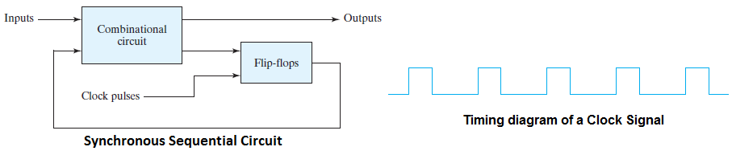
Synchronous Sequential Circuits (3/3)
Synchronous sequential circuits that use clock pulses to control storage elements are called clocked sequential circuits
They are called synchronous circuits because the activity within the circuit and the resulting updating of stored values is synchronized to the occurrence of clock pulses
The storage elements (memory) used in clocked sequential circuits are called flip flops

Slide 10
Storage Elements
A storage element in a digital circuit can maintain a binary state indefinitely (as long as power is delivered to the circuit), until directed by an input signal to switch states
There are two types of storage elements
Latches
Storage elements that operate with signal levels are referred to as latches
Flip Flops
Storage elements that are controlled by a clock transition are flip-flops

Slide 11
Latches
Storage elements that operate with signal levels are referred to as latches
Latches are said to be level sensitive devices
Latches are used for the design of asynchronous sequential circuits
The knowledge of latches is important as they are the basic circuits from which all flip-flops are constructed
Here we will discuss two types of latches
SR Latch
D Latch

Slide 12
SR Latch
The SR latch is a circuit with two cross-coupled NOR gates or two cross-coupled NAND gates
Two inputs
S (stands for set)
R (stands for reset)
Two outputs Q and Q’ determine two possible states
If Q = 1 latch is in set state
If Q = 0 latch is in reset state

Slide 13
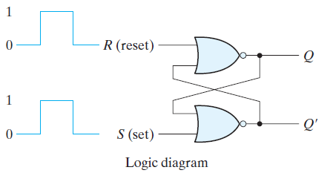
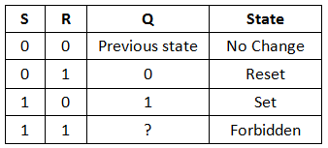
SR Latch with NOR Gate (1/2)
Works on active high state
It is mandatory to connect R with the gate producing Q and S with the gate producing Q’
Case 1 (S = 0 R = 0)
No change in state
Case 2 (S = 0 R = 1)
Q = 0 Q’ = 1
Reset State
Case 3 (S = 1 R = 0)
Q = 1 Q’ = 0
Set State
Case 4 (S = 1 R = 1)
Q = 0 Q’ = 0
Practically Impossible
Indeterminate state

Slide 14
SR Latch with NOR Gate (2/2)
Under normal conditions, both inputs of the latch remain at 0 unless the state has to be changed
The application of a momentary 1 to the S input causes the latch to go to the set state
The S input must go back to 0 before any other changes take place, in order to avoid the occurrence of an undefined next state
The application of a momentary 1 to the R input causes the latch to go to the Reset state

Slide 15
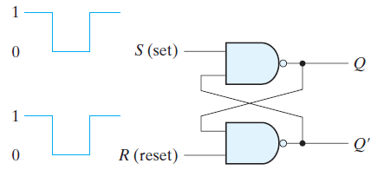
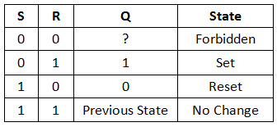
SR Latch with NAND Gate (1/2)
Works on active low state
It is mandatory to connect S with the gate producing Q and R with the gate producing Q’
Case 1 (S = 0 R = 0)
Q = 1 Q’ = 1
Practically Impossible
Indeterminate state
Case 2 (S = 0 R = 1)
Q = 1 Q’ = 0
Set State
Case 3 (S = 1 R = 0)
Q = 0 Q’ = 1
Reset State
Case 4 (S = 1 R = 1)
No change in state

Slide 16
SR Latch with NAND Gate (2/2)
Also called S’R’ Latch
Under normal conditions, both inputs of the latch remain at 1 unless the state has to be changed
The application of a momentary 0 to the S input causes the latch to go to the set state
The S input must go back to 1 before any other changes take place, in order to avoid the occurrence of an undefined next state
The application of a momentary 0 to the R input causes the latch to go to the Reset state

Slide 17
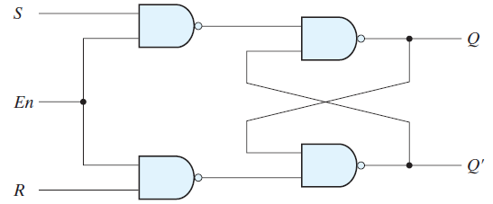
SR Latch with Enable Input (1/2)
The operation of the basic SR latch can be modified by providing an additional input signal that determines (controls) when the state of the latch can be changed by determining whether S and R can affect the circuit
The outputs of the NAND gates stay at the logic-1 level as long as the enable signal remains at 0

Slide 18
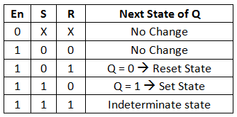
SR Latch with Enable Input (2/2)
En = 0; S = R = X
No change in state
En = 1; S = 0; R = 0
No change in state
En = 1; S = 0; R = 1
Q = 0 Q’ = 1
Reset State
En = 1; S = 1; R = 0
Q = 1 Q’ = 0
Set State
En = 1; S = 1; R = 1
Q = 1 Q’ = 1
Practically Impossible
Indeterminate state

Slide 19
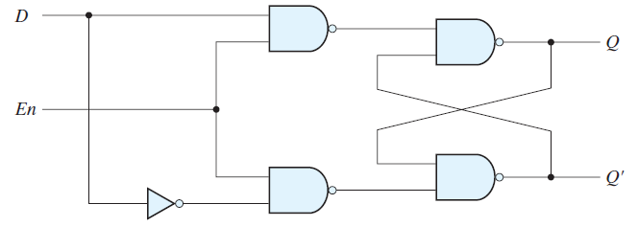
D Latch (1/2)
One way to eliminate the undesirable condition of the indeterminate state in the SR latch is to ensure that inputs S and R are never equal to 1 at the same time
This is done in the D latch (which is also called transparent latch)

Slide 20
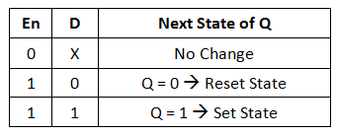
D Latch (2/2)
Case 1 (En = 0; D = X)
No change in state
Case 2 (En = 1; D = 0)
Q = 0
Reset State
Case 3 (En = 1; D = 1)
Q = 1
Set State

Slide 21
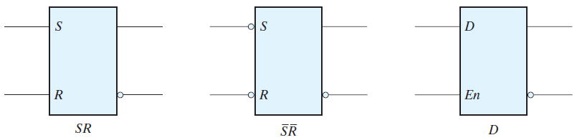
Graphical Symbols of Latches
Inputs to the left
Outputs to the right
SR latch is constructed with NOR gates
S’R’ latch is constructed with NAND gate

Slide 22
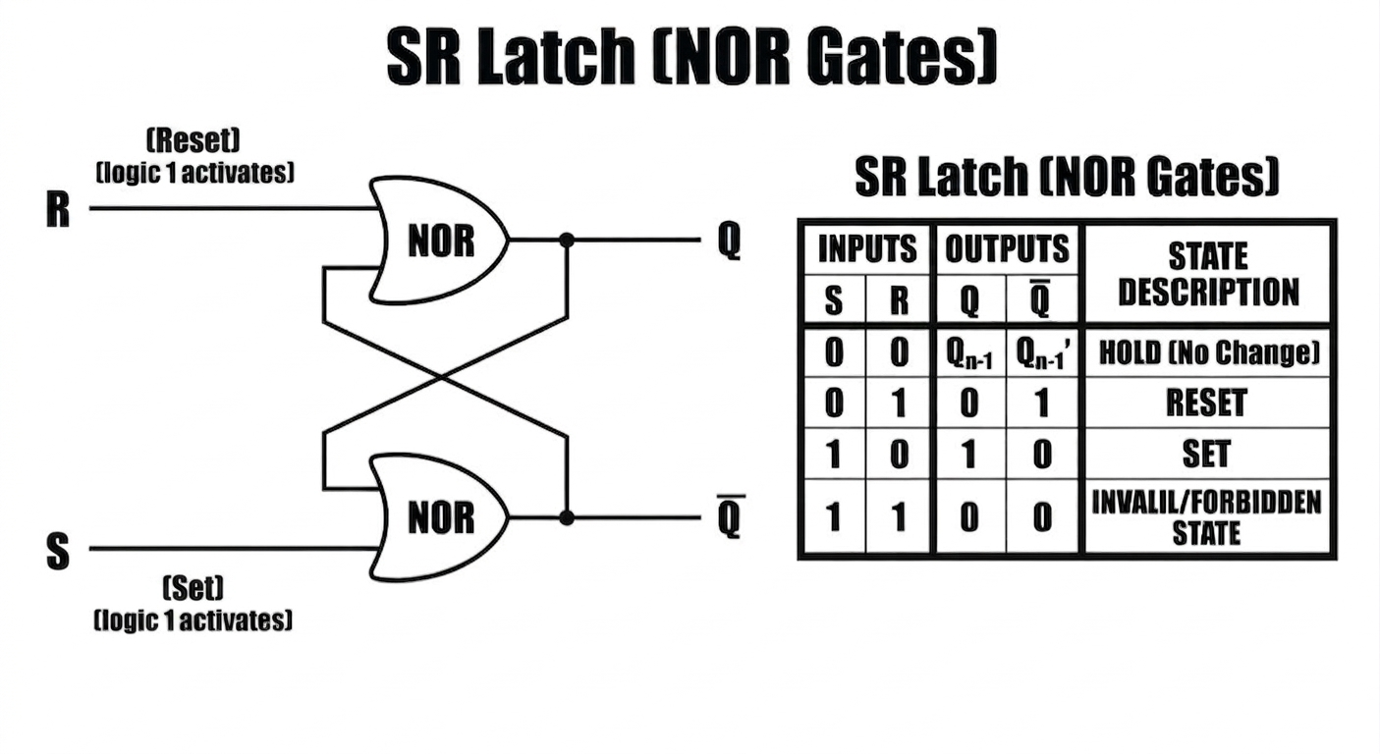

Slide 23
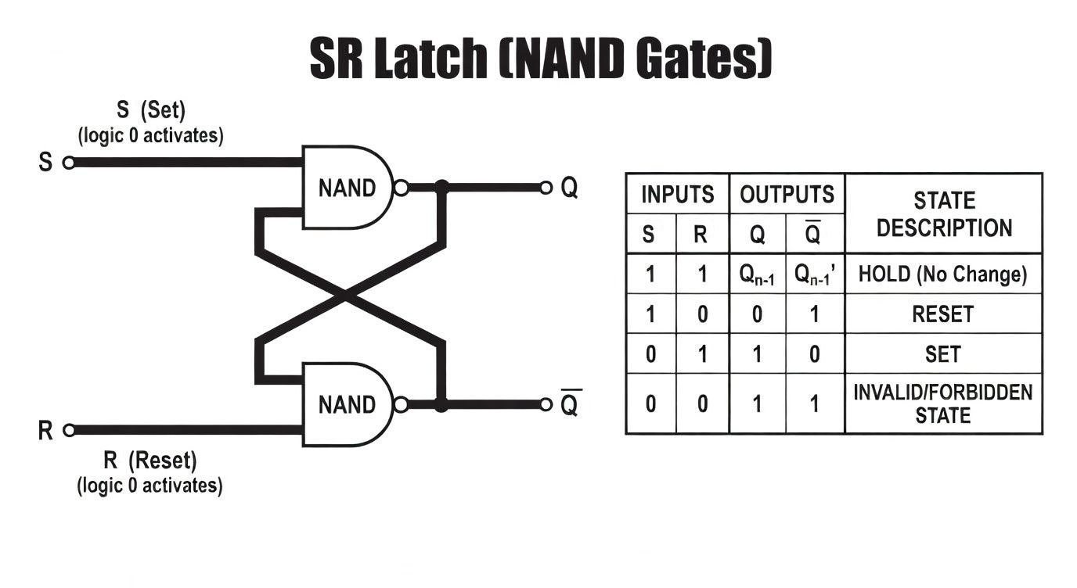

Slide 24
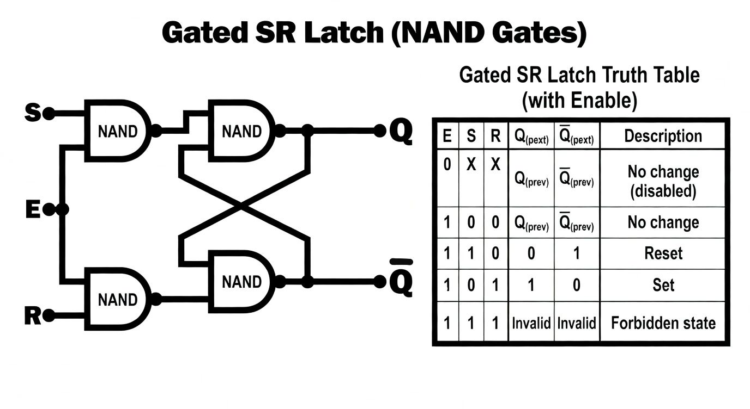

Slide 25
